Slide 1
Behavioral Patterns part -IV
Emre Kaplan, Ph.D.

Slide 2
Behavioral Patterns
Behavioral patterns are concerned with algorithms and the assignment of responsibilities between objects.
Behavioral patterns describe not just patterns of objects or classes but also the patterns of communication between them.
These patterns characterize complex control flow that's difficult to follow at run-time. They shift your focus away from flow of control to let you concentrate just on the way objects are interconnected.
Behavioral object patterns use object composition rather than inheritance.
Source: Erich Gamma, Richard Helm, Ralph Johnson, and John Vlissides. 1995. Design Patterns: Elements of Reusable Object-Oriented Software. Addison-Wesley Longman Publishing Co., Inc., Boston, MA, USA.

Slide 3
Behavioral Patterns
Behavioral Patterns
Template Method
Observer
Null Object
Iterator
State
Mediator
Strategy
Command
Visitor
Chain of Responsibility
Memento
Dependency Injection

Slide 4
Chain of Responsibility
Intent
Avoid coupling the sender of a request to its receiver by giving more than one object a chance to handle the request. Chain the receiving objects and pass the request along the chain until an object handles it.
Notes:
The idea of this pattern is to decouple senders and receivers by giving multiple objects a chance to handle a request. The request gets passed along a chain of objects until one of them handles it

Slide 5
Chain of Responsibility
The first object in the chain receives the request and either handles it or forwards it to the next candidate on the chain, which does likewise.
The object that made the request has no explicit knowledge of who will handle it—we say the request has an implicit receiver.
To forward the request along the chain, and to ensure receivers remain implicit,
each object on the chain shares a common interface for handling requests and for accessing its successor on the chain.

Slide 6
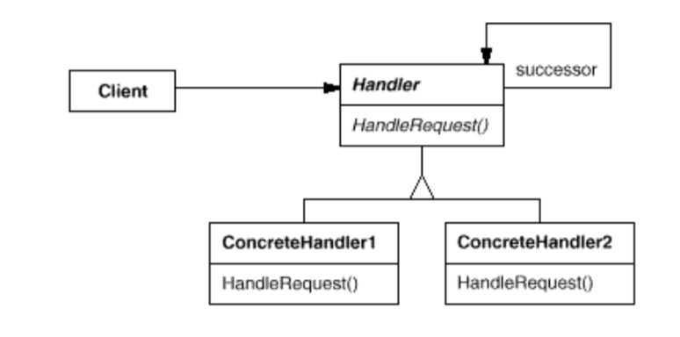
Structure

Slide 7
Structure
https://upload.wikimedia.org/wikipedia/commons/6/6a/W3sDesign_Chain_of_Responsibility_Design_Pattern_UML.jpg

Slide 8
Participants
Handler
defines an interface for handling requests. o (optional) implements the successor link.
ConcreteHandler
handles requests it is responsible for.
can access its successor.
if the ConcreteHandler can handle the request, it does so; otherwise it forwards the request to its successor.
Client
initiates the request to a ConcreteHandler object on the chain.

Slide 9
Chain of Responsibility
Use Chain of Responsibility when:
more than one object may handle a request, and the handler isn't known a priori. The handler should be ascertained automatically.
you want to issue a request to one of several objects without specifying the receiver explicitly.
the set of objects that can handle a request should be specified dynamically.
Notes:
The idea of this pattern is to decouple senders and receivers by giving multiple objects a chance to handle a request. The request gets passed along a chain of objects until one of them handles it

Slide 10
Consequences
Chain of Responsibility has the following benefits and liabilities:
Reduced coupling.
The pattern frees an object from knowing which other object handles a request. An object only has to know that a request will be handled "appropriately."
Both the receiver and the sender have no explicit knowledge of each other, and an object in the chain doesn't have to know about the chain's structure.
Added flexibility in assigning responsibilities to objects.
You can add or change responsibilities for handling a request by adding to or otherwise changing the chain at run-time.
Receipt isn't guaranteed.
Since a request has no explicit receiver, there's no guarantee it'll be handled.
the request can fall off the end of the chain without ever being handled.
a request can also go unhandled when the chain is not configured properly.
Notes:
Chain of Responsibility can simplify object interconnections. Instead of objects maintaining references to all candidate receivers, they keep a single reference to their successor.

Slide 11
Drawbacks
Mostly, it can get broken easily:
if a processor fails to call the next processor, the command gets dropped
if a processor calls the wrong processor, it can lead to a cycle
It can create deep stack traces, which can affect performance
It can lead to duplicate code across processors, increasing maintenance
https://www.baeldung.com/chain-of-responsibility-pattern

Slide 12
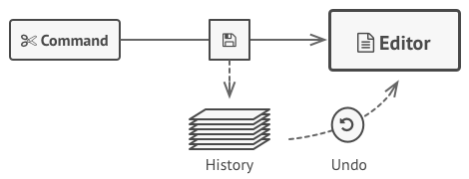
Memento
Without violating encapsulation, capture and externalize an object's internal state so that the object can be restored to this state later.
Memento pattern is used to restore state of an object to a previous state.

Slide 13
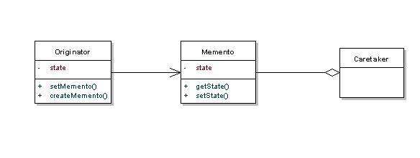
Memento
Memento pattern uses three actor classes.
Memento contains state of an object to be restored
Originator creates and stores states in Memento objects
Caretaker object is responsible to restore object state from Memento

Slide 14
Memento
Memento pattern is useful when:
Produce snapshots of the object’s state to be able to restore a previous state of the object.
Provide an undo mechanism, when the internal state of an object may need to be restored at a later stage.
Using serialization along with this pattern, it's easy to preserve the object state and bring it back later on.

Slide 15
Dependency Injection
Inversion of Control.
A class should not configure its dependencies statically but should be configured from outside.
Avoid direct object creation. (i.e. do not use new)
Hard Dependency
If a class creates an instance of another class via the new operator, it cannot be used (and tested) independently from this class and this is called a hard dependency.
Solution
Receive dependent objects so that mock objects can also be used for testing in isolation.
Mock objects (mocks) are objects which behave similar as the real object. But these mocks are not programmed; they are configured to behave in a certain predefined way.

Slide 16
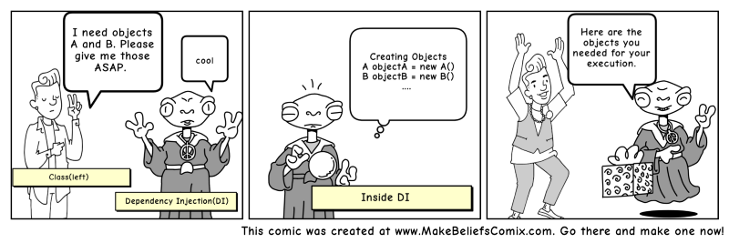
Dependency Injection
Transferring the task of creating the object to someone else and directly using the dependency is called dependency injection.

Slide 17
Dependency Injection
Dependency injection can be performed on:
the constructor of the class (construction injection)
a field (field injection)
the parameters of a method (method injection)
Avoiding dependency injection on static fields and methods is a good practice
Static fields will be injected after the first object of the class was created via DI, which means no access to the static field in the constructor
Static fields can not be marked as final, otherwise the compiler or the application complains at runtime about them
Static methods are called only once after the first instance of the class was created

Slide 18
Dependency Injection
There are many DI frameworks for almost all major programming languages.
Popular DI Frameworks (short list)
Guice (Java)
Castle Windsor (.NET)
Spring Python (Python)

Slide 19
Dependency Injection References
This presentation compiles some images and text from these resources which are listed below as further reading materials:
https://www.freecodecamp.org/news/a-quick-intro-to-dependency-injection-what-it-is-and-when-to-use-it-7578c84fa88f/
https://www.vogella.com/tutorials/DependencyInjection/article.html
https://www.journaldev.com/2394/java-dependency-injection-design-pattern-example-tutorial
https://stackify.com/dependency-injection/
https://dzone.com/articles/about-dependency-injection
http://www.javacreed.com/why-should-we-use-dependency-injection/
https://www.codejava.net/coding/what-is-dependency-injection-with-java-code-example
Notes:
Dependency Injection vs Service Locator
https://www.martinfowler.com/articles/injection.html

